Slide 1
Unit 10
Dependability & Security

Slide 2
The software should be available when required and should operate correctly and without undesirable side effects, such as unauthorized information disclosure.
Dependability was proposed by Laprie (1995) to cover the related systems attributes of availability, reliability, safety, and security.

Slide 3
The dependability of systems is now usually more important than their detailed functionality for the following reasons:
System failures affect a large number of people.
Users often reject systems that are unreliable, unsafe, or insecure.
System failure costs may be enormous.
Undependable systems may cause information loss.

Slide 4
The dependability of systems is now usually more important than their detailed functionality for the following reasons:
System failures affect a large number of people. Many systems include functionality that is rarely used. If this functionality were left out of the system, only a small number of users would be affected. System failures, which affect the availability of a system, potentially affect all users of the system. Failure may mean that normal business is impossible.
Users often reject systems that are unreliable, unsafe, or insecure. If users find that a system is unreliable or insecure, they will refuse to use it. Furthermore, they may also refuse to buy or use other products from the same company that produced the unreliable system, because they believe that these products are also likely to be unreliable or insecure.

Slide 5
The dependability of systems is now usually more important than their detailed functionality for the following reasons:
System failure costs may be enormous. For some applications, such as a reactor control system or an aircraft navigation system, the cost of system failure is orders of magnitude greater than the cost of the control system.
Undependable systems may cause information loss. Data is very expensive to collect and maintain; it is usually worth much more than the computer system on which it is processed. The cost of recovering lost or corrupt data is usually very high.

Slide 6
Software is always part of a broader system. It executes in an operational environment that includes the hardware on which the software executes, the human users of that software, and the organizational or business processes where the software is used.
When designing a dependable system, you therefore have to consider:
Hardware failure
Software failure
Operational failure

Slide 7
When designing a dependable system, you therefore have to consider:
Hardware failure: System hardware may fail because of mistakes in its design, because components fail as a result of manufacturing errors, or because the components have reached the end of their natural life.
Software failure: System software may fail because of mistakes in its specification, design, or implementation.
Operational failure: Human users may fail to use or operate the system correctly. As hardware and software have become more reliable, failures in operation are now, perhaps, the largest single cause of system failures.

Slide 8
Dependability properties
The dependability of a computer system is a property of the system that reflects its trustworthiness.
Trustworthiness here essentially means the degree of confidence a user has that the system will operate as they expect, and that the system will not ‘fail’ in normal use. It is not meaningful to express dependability numerically.
Rather, we use relative terms such as ‘not dependable,’ ‘very dependable,’ and ‘ultra-dependable’ to reflect the degrees of trust that we might have in a system.

Slide 9
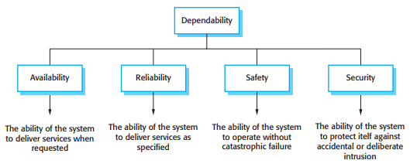
Dependability properties
Four Principal Dimensions to Dependability

Slide 10
Dependability properties
Availability: Informally, the availability of a system is the probability that it will be up and running and able to deliver useful services to users at any given time.
Reliability: Informally, the reliability of a system is the probability, over a given period of time, that the system will correctly deliver services as expected by the user. Reliability includes ‘correctness’ (ensuring the system services are as specified).
Safety: Informally, the safety of a system is a judgment of how likely it is that the system will cause damage to people or its environment.
Security: Informally, the security of a system is a judgment of how likely it is that the system can resist accidental or deliberate intrusions. Security includes ‘integrity’ (ensuring that the systems program and data are not damaged) and ‘confidentiality’ (ensuring that information can only be accessed by people who are authorized).

Slide 11
Dependability properties
The dependability properties shown in above figure are complex properties that can be broken down into a number of other, simpler properties.
For example,
Security includes ‘integrity’ (ensuring that the systems program and data are not damaged) and ‘confidentiality’ (ensuring that information can only be accessed by people who are authorized).
Reliability includes ‘correctness’ (ensuring the system services are as specified),
Precision : ensuring information is delivered at an appropriate level of detail.
Timeliness: ensuring that information is delivered when it is required).

Slide 12
Dependability properties
Four main dependability properties, you may also think of other System Properties as dependability properties:
Repairability
Maintainability
Survivability
Error tolerance

Slide 13
Dependability properties
Four main dependability properties, you may also think of other System Properties as dependability properties:
Repairability: System failures are inevitable, but the disruption caused by failure can be minimized if the system can be repaired quickly. For that to happen, it must be possible to diagnose the problem, access the component that has failed, and make changes to fix that component. Repairability in software is enhanced when the organization using the system has access to the source code and has the skills to make changes to it. Open source software makes this easier but the reuse of components can make it more difficult.

Slide 14
Dependability properties
Four main dependability properties, you may also think of other System Properties as dependability properties:
Maintainability: As systems are used, new requirements emerge and it is important to maintain the usefulness of a system by changing it to accommodate these new requirements. Maintainable software is software that can be adapted economically to cope with new requirements, and where there is a low probability that making changes will introduce new errors into the system.

Slide 15
Dependability properties
Four main dependability properties, you may also think of other System Properties as dependability properties:
Survivability: A very important attribute for Internet-based systems is survivability. Survivability is the ability of a system to continue to deliver service whilst under attack and, potentially, whilst part of the system is disabled. Work on survivability focuses on identifying key system components and ensuring that they can deliver a minimal service.
Three strategies are used to enhance survivability
resistance to attack
attack recognition
recovery from the damage caused by an attack

Slide 16
Dependability properties
Four main dependability properties, you may also think of other System Properties as dependability properties:
Error tolerance: This property can be considered as part of usability and reflects the extent to which the system has been designed so that user input errors are avoided and tolerated. When user errors occur, the system should, as far as possible, detect these errors and either fix them automatically or request the user to reinput their data.

Slide 17
Dependability properties
To develop dependable software, you therefore need to ensure that:
You avoid the introduction of accidental errors into the system during software specification and development.
You design verification and validation processes that are effective in discovering residual errors that affect the dependability of the system.
You design protection mechanisms that guard against external attacks that can compromise the availability or security of the system.
You configure the deployed system and its supporting software correctly for its operating environment.

Slide 18
Dependability properties
Fault Tolerance means that dependable systems have to include redundant code to help them monitor themselves, detect erroneous states, and recover from faults before failures occur.
This affects the performance of systems, as additional checking is required each time the system executes. Therefore, designers usually have to trade off performance and dependability.
For Example: You may need to leave checks out of the system because these slow the system down. However, the consequential risk here is that some failures occur because a fault has not been detected.

Slide 19
Availability and reliability
System availability and reliability are closely related properties that can both be expressed as numerical probabilities.
The availability of a system is the probability that the system will be up and running to deliver these services to users on request. The reliability of a system is the probability that the system’s services will be delivered as defined in the system specification.

Slide 20
Availability and reliability
Reliability and availability are closely related but sometimes one is more important than the other.
If users expect continuous service from a system then the system has a high availability requirement. It must be available whenever a demand is made.
If the losses that result from a system failure are low and the system can recover quickly then failures don’t seriously affect system users. In such systems, the reliability requirements may be relatively low.

Slide 21
Availability and reliability
System Reliability and Availability may be defined more precisely as follows:
Reliability: The probability of failure-free operation over a specified time, in a given environment, for a specific purpose.
Availability: The probability that a system, at a point in time, will be operational and able to deliver the requested services.

Slide 22
Availability and reliability
These standard definitions of availability and reliability do not take into account the severity of failure or the consequences of unavailability.
People often accept minor system failures but are very concerned about serious failures that have high consequential costs.
For example, computer failures that corrupt stored data are less acceptable than failures that freeze the machine and that can be resolved by restarting the computer.

Slide 23
Availability and reliability
A strict definition of reliability relates the system implementation to its specification.
The system is behaving reliably if its behavior is consistent with that defined in the specification. However, a common cause of perceived unreliability is that the system specification does not match the expectations of the system users.

Slide 24
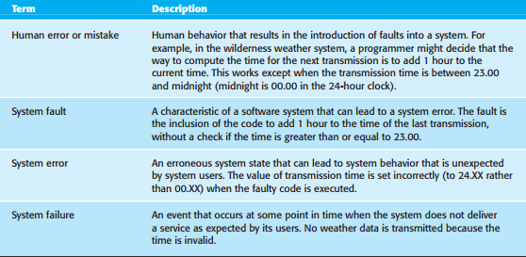
Availability and reliability
Reliability terminology

Slide 25
Availability and reliability
System reliability and availability problems are mostly caused by system failures.
Some of these failures are a consequence of specification errors or failures in other related systems such as a communications system. However, many failures are a consequence of erroneous system behavior that derives from faults in the system.
When discussing reliability, it is helpful to use precise terminology and distinguish between the terms ‘fault,’ ‘error,’ and ‘failure.’

Slide 26
Availability and reliability
Reliability of a program depends on the number of inputs causing erroneous outputs (failures) during normal use of the system by most users.
Software faults that only occur in exceptional situations have little practical effect on the system’s reliability. Consequently, removing software faults may not significantly improve the overall reliability of the system.

Slide 27
Availability and reliability
System faults do not always result in system errors and system errors do not necessarily result in system failures.
The reasons for this are as follows:
Not all code in a program is executed. The code that includes a fault (e.g., the failure to initialize a variable) may never be executed because of the way that the software is used.
Errors are transient. A state variable may have an incorrect value caused by the execution of faulty code. However, before this is accessed and causes a system failure, some other system input may be processed that resets the state to a valid value.
The system may include fault detection and protection mechanisms. These ensure that the erroneous behavior is discovered and corrected before the system services are affected.

Slide 28
Availability and reliability
The distinction between faults, errors, and failures helps identify three complementary approaches that are used to improve the reliability of a system:
Fault avoidance: Development techniques are used that either minimize the possibility of human errors and/or that trap mistakes before they result in the introduction of system faults. Examples of such techniques include avoiding error-prone programming language constructs such as pointers and the use of static analysis to detect program anomalies.
Fault detection and removal: The use of verification and validation techniques that increase the chances that faults will be detected and removed before the system is used. Systematic testing and debugging is an example of a fault detection technique.

Slide 29
Availability and reliability
Fault tolerance: These are techniques that ensure that faults in a system do not result in system errors or that system errors do not result in system failures. The incorporation of self-checking facilities in a system and the use of redundant system modules are examples of fault tolerance techniques.

Slide 30
Safety
Safety-critical systems are systems where it is essential that system operation is always safe; that is, the system should never damage people or the system’s environment even if the system fails.
Hardware control of safety-critical systems is simpler to implement and analyze than software control. However, we now build systems of such complexity that they cannot be controlled by hardware alone.
Software control is essential because of the need to manage large numbers of sensors and actuators with complex control laws.
For example, advanced, aerodynamically unstable, military aircraft require continual software-controlled adjustment of their flight surfaces to ensure that they do not crash.

Slide 31
Safety
Safety-critical software falls into two classes:
Primary safety-critical software: This is software that is embedded as a controller in a system. Malfunctioning of such software can cause a hardware malfunction, which results in human injury or environmental damage.
Secondary safety-critical software: This is software that can indirectly result in an injury. An example of such software is a computer-aided engineering design system whose malfunctioning might result in a design fault in the object being designed. This fault may cause injury to people if the designed system malfunctions.

Slide 32
Safety
There are four reasons why software systems that are reliable are not necessarily safe:
We can never be 100% certain that a software system is fault-free and fault tolerant. Undetected faults can be dormant for a long time and software failures can occur after many years of reliable operation.
The specification may be incomplete in that it does not describe the required behavior of the system in some critical situations. A high percentage of system malfunctions are the result of specification rather than design errors.

Slide 33
Safety
There are four reasons why software systems that are reliable are not necessarily safe:
Hardware malfunctions may cause the system to behave in an unpredictable way, and present the software with an unanticipated environment. When components are close to physical failure, they may behave erratically and generate signals that are outside the ranges that can be handled by the software.
The system operators may generate inputs that are not individually incorrect but which, in some situations, can lead to a system malfunction. (Mechanical malfunction)

Slide 34
Safety
The key to assuring safety is to ensure either that accidents do not occur or that the consequences of an accident are minimal.
This can be achieved in three complementary ways:
Hazard avoidance: The system is designed so that hazards are avoided. For example, a cutting system that requires an operator to use two hands to press separate buttons simultaneously avoids the hazard of the operator’s hands being in the blade pathway.
Hazard detection and removal: The system is designed so that hazards are detected and removed before they result in an accident. For example, a chemical plant system may detect excessive pressure and open a relief valve to reduce these pressures before an explosion occurs.

Slide 35
Safety
Damage limitation: The system may include protection features that minimize the damage that may result from an accident. For example, an aircraft engine normally includes automatic fire extinguishers. If a fire occurs, it can often be controlled before it poses a threat to the aircraft.

Slide 36
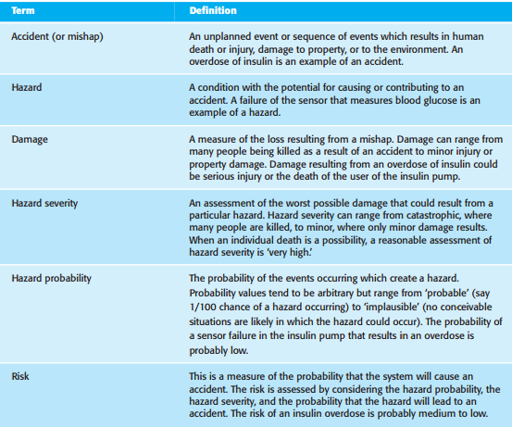
Safety: Safety Terminology

Slide 37
Security
Security is a system attribute that reflects the ability of the system to protect itself from external attacks, which may be accidental or deliberate.
These external attacks are possible because most general-purpose computers are now networked and are therefore accessible by outsiders.
Examples of attacks might be the installation of viruses and Trojan horses, unauthorized use of system services or unauthorized modification of a system or its data. If you really want a secure system, it is best not to connect it to the Internet. Then, your security problems are limited to ensuring that authorized users do not abuse the system. In practice, however, there are huge benefits from networked access for most large systems so disconnecting from the Internet is not cost effective.

Slide 38
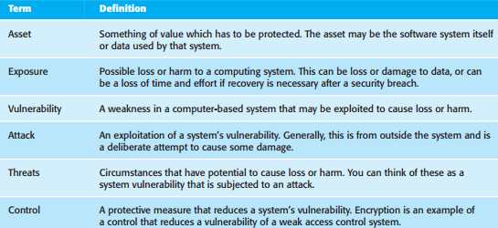
Security: Security terminology

Slide 39
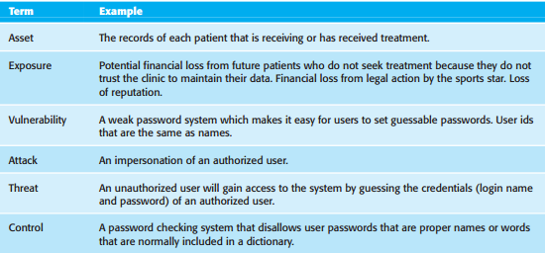
Security: Example Security terminology

Slide 40
Security
In any networked system, there are three main types of security threats:
Threats to the confidentiality of the system and its data These can disclose information to people or programs that are not authorized to have access to that information.
Threats to the integrity of the system and its data These threats can damage or corrupt the software or its data.
Threats to the availability of the system and its data These threats can restrict access to the software or its data for authorized users.

Slide 41
Security
These threats are, of course, interdependent. If an attack makes the system unavailable, then you will not be able to update information that changes with time. This means that the integrity of the system may be compromised.
If an attack succeeds and the integrity of the system is compromised, then it may have to be taken down to repair the problem. Therefore, the availability of the system is reduced.

Slide 42
Security
The controls that you might put in place to enhance system security are comparable to those for reliability and safety:
Vulnerability avoidance
Attack detection and neutralization
Exposure limitation and recovery

Slide 43
Security
The controls that you might put in place to enhance system security are comparable to those for reliability and safety:
Vulnerability avoidance: Controls that are intended to ensure that attacks are unsuccessful. The strategy here is to design the system so that security problems are avoided.
For example, sensitive military systems are not connected to public networks so that external access is impossible. You should also think of encryption as a control based on avoidance. Any unauthorized access to encrypted data means that it cannot be read by the attacker. In practice, it is very expensive and time consuming to crack strong encryption.

Slide 44
Security
Attack detection and neutralization: Controls that are intended to detect and repel attacks. These controls involve including functionality in a system that monitors its operation and checks for unusual patterns of activity. If these are detected, then action may be taken, such as shutting down parts of the system, restricting access to certain users, etc.
Exposure limitation and recovery: Controls that support recovery from problems. These can range from automated backup strategies and information ‘mirroring’ to insurance policies that cover the costs associated with a successful attack on the system.

Slide 45
Security
Without a reasonable level of security, we cannot be confident in a system’s availability, reliability, and safety.
Methods for certifying availability, reliability, and security assume that the operational software is the same as the software that was originally installed.
If the system has been attacked and the software has been compromised in some way (for example, if the software has been modified to include a worm), then the reliability and safety arguments no longer hold.
Errors in the development of a system can lead to security loopholes. If a system does not respond to unexpected inputs or if array bounds are not checked, then attackers can exploit these weaknesses to gain access to the system

